Slide 1
Angular 7
By Yogesh Patel

Slide 2
Development Machine Setup (Linux)
Install NodeJS and NPM. Steps for Ubuntu:
Step 1
Update the package manager and Remove old version of node
sudo apt-get update
sudo apt-get remove --purge node
Step 2
Add the required repository to your system and update the package manager
curl -sL https://deb.nodesource.com/setup_6.x | sudo -E bash -
Step 3
Use this command to install Node.js and npm
sudo apt-get install -y nodejs
Step 4
Verify that Node.js and NPM is installed
node --version
npm --version

Slide 3
Development Machine Setup (Linux)
Browser & Code editor setup
Install Google Chrome browser
Step 1
cd /tmp
wget https://dl.google.com/linux/direct/google-chrome-stable_current_amd64.deb
sudo dpkg -i google-chrome-stable_current_amd64.deb
sudo apt-get -f install
Step 2
Install Visual Studio Code
Download .deb file from - https://code.visualstudio.com/download
sudo dpkg –i /home/yogesh/Downloads/<file>.deb
sudo apt-get install –f # Install dependencies
Step 3
Project directory
~$ mkdir demoApp
~$ cd demoApp

Slide 4
Development Machine Setup (Windows)
Install NodeJS and NPM.
Step 1
Download and install NodeJS
https://nodejs.org/en/download/
Step 2
Check the installation, below commands should reveal installed versions
C:\>node -v
C:\>npm -v

Slide 5
Web Application

Slide 6
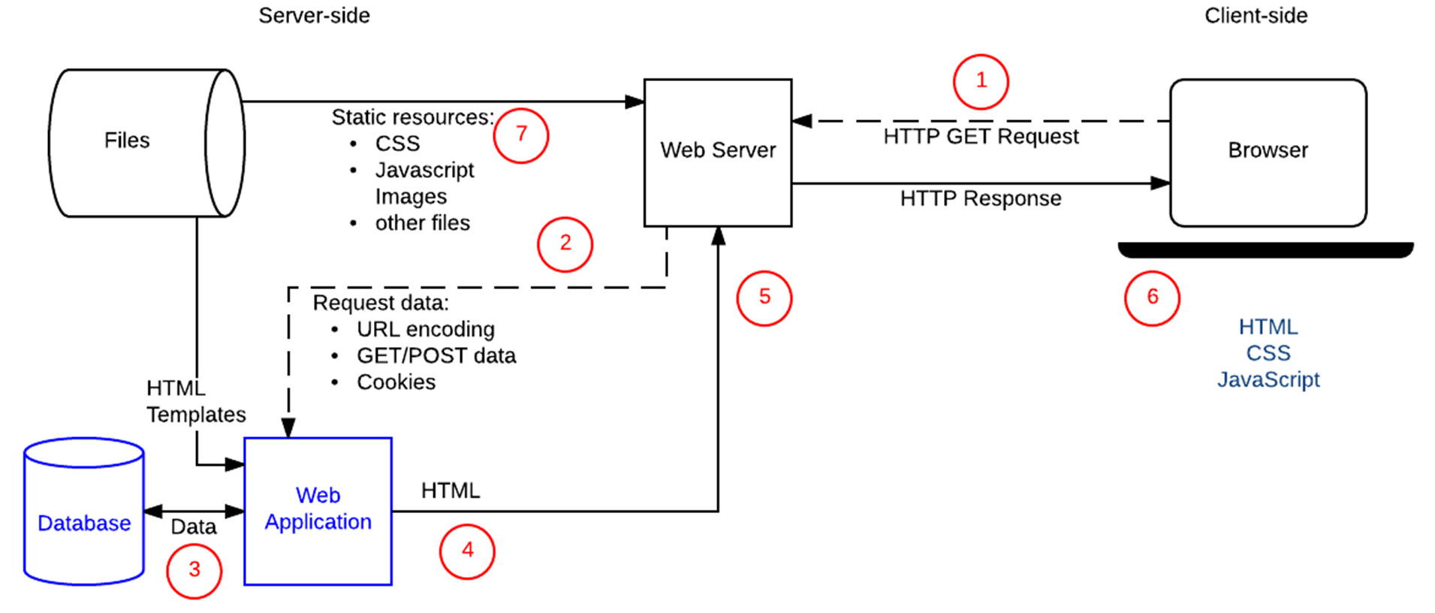
Web Application
Client–server software application in which the client (or user interface) runs in a web browser.

Slide 7
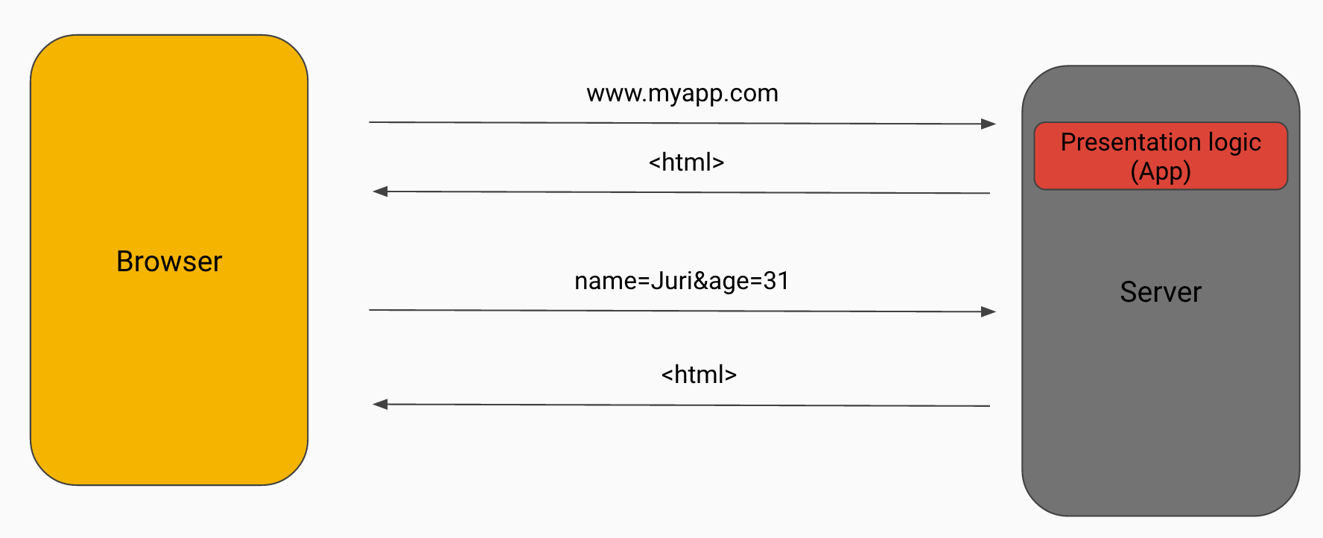
Web Application architecture 1
Server-side rendered
When the user interacts with the page, that request gets again sent to the server, which in turn generates a new HTML page and serves it back to the browser.

Slide 8
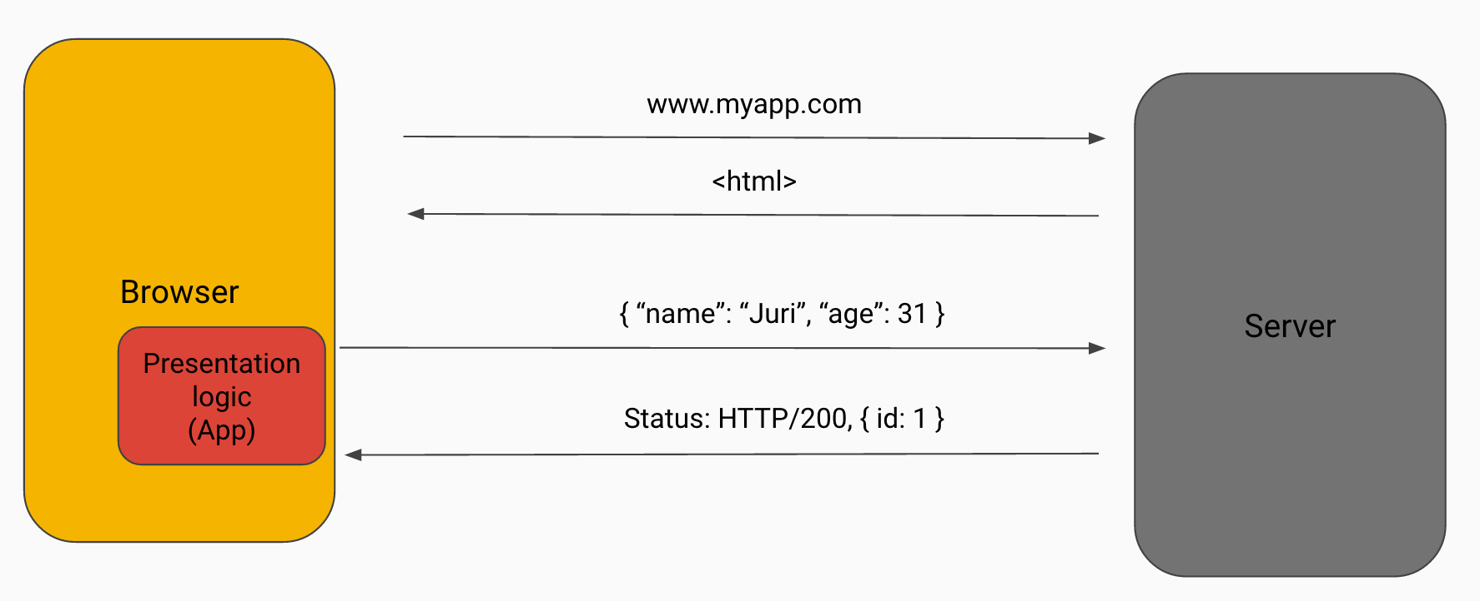
Web Application architecture 2
Client-side rendered
User action doesn’t reload the entire web site again, but rather the data for that specific user interaction is sent to the server (usually by JSON format) and the server in turn responds with the just the amount of data requested by the JavaScript client.

Slide 9
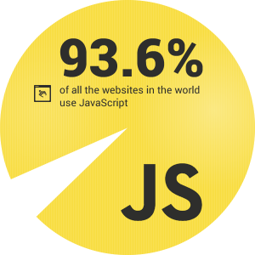
Javascript
JavaScript, often abbreviated as JS, is a high-level, dynamic, weakly typed, prototype-based, multi-paradigm, and interpreted programming language.
Make things happen in the user's browser without sending messages back and forth to the server.
Client-side validation
Dynamic drop-down menus
Displaying data and time
Displaying popup windows and dialog boxes (like alert dialog box, confirm dialog box and prompt dialog box)
Displaying clocks etc.
Dynamically access and update the content, structure, and style of a document using Javascript DOM.

Slide 10
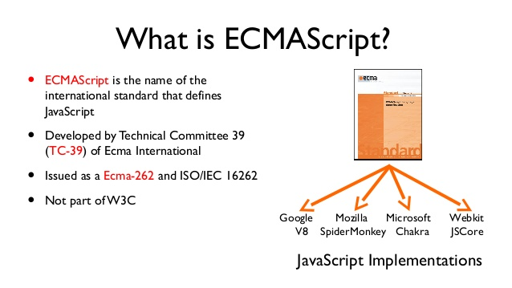
ECMAScript

Slide 11
ECMAScript
Standardized Javascript
So far ECMAScript1 through ECMAScript2018
Most modern browsers support ECMAScript5
ECMAScript6 = ES6 = ES2015 = ECMAScript2015
Transpiler can compile ECMAScript6 to ECMAScript5
Whats new in ECMAScript 6?
https://www.w3schools.com/js/js_es6.asp
More info on ECMAScript versions and Browser compatibility - https://www.w3schools.com/js/js_versions.asp

Slide 12
ECMAScript + Babel Demo App
Step by Step
npm init
npm install babel-cli babel-core --save-dev
npm install babel-preset-es2015 --save-dev
"scripts": {
"babel": "babel --presets es2015 js/main.js -o build/main.bundle.js",
}

Slide 13
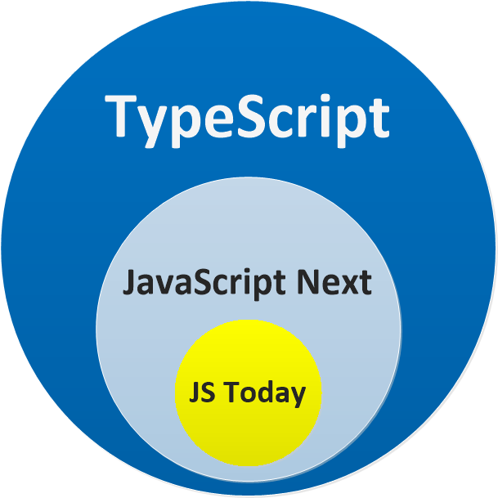
TypeScript
Strongly typed scripting language
Free and open-source programming language developed and maintained by Microsoft
Typed superset of JavaScript
Compiles to plain JavaScript
Benefits - Intellisense, Aotucomplete, Strongly Typed, Classes, Interfaces, Inheritance
Supported editors – Visual Studio Code, WebStorm, Atom, Sublime Text, etc…
Install typescript using NPM –
sudo npm install –g typescript

Slide 14
Typescript demo app
Step by Step
npm install -g typescript
tsc --version
Create a main.ts file
Compile typescript
tsc main.ts
Refer generated JS files in HTML

Slide 15
Angular
Basics of Angular JS / Angular 1.X
Angular is by far the most popular JavaScript framework for dynamic web apps.
Mainly maintained by Google with support from open source community.
AngularJS lets you extend HTML vocabulary for your application.
Plain Javascript
SPA
Data Binding
Dependency Injection
Testing

Slide 16
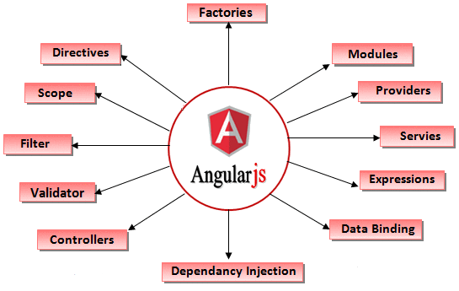
Angular 1.X features

Slide 17
Angular 2
Basics of Angular / Angular 2.X
Complete re-write
Components: Controllers & scopes are replaced with components
Performance: Angular 2 is 5 times faster than AngularJS 1
Cross Platform: Single app that works across Mobile & desktop devices
Mobile: Angular 2 is made keeping in mind mobile oriented architecture
Language options: TypeScript, Dart, ECMAScript5, ECMAScript6(ES 2015), etc…
SEO friendly

Slide 18
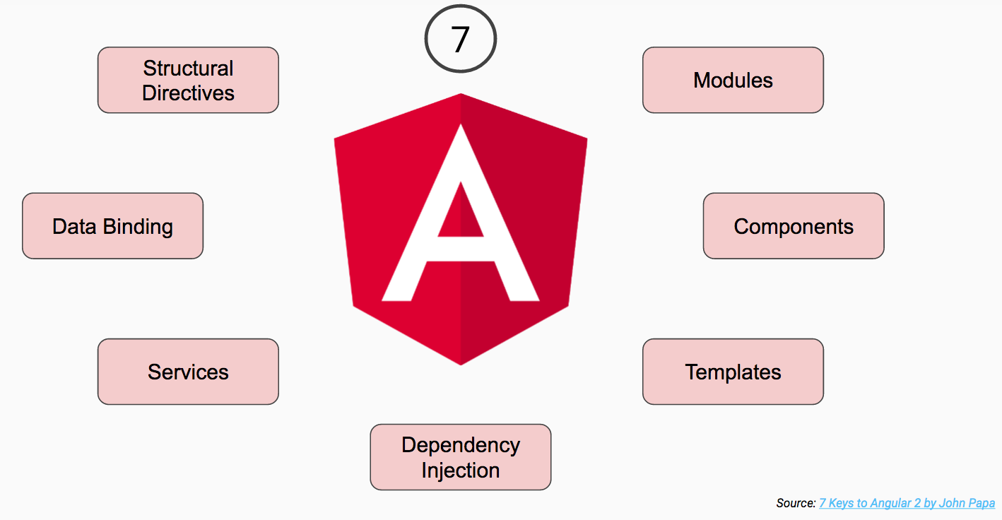
Angular 2 - Key Concepts
Basics of Angular / Angular 2.X

Slide 19
Angular 4
Basics of Angular 4 – What about Angular 3?
Reduced the size of the generated code for your components by around 60% in most cases
Faster Compilation
TypeScript 2.1 and 2.2 compatibility; earlier upto 1.8 was supported
Animations: segregated animation package from @angular/core as a separate and dedicated package
Router: A new interface has been introduced to represent the parameters of a URL - ParamMap
*ngIf with else
The template tag is now deprecated; use the ng-template tag instead.
new titlecase pipe: ‘Foo Bar’

Slide 20
Angular 5
Whats new in Angular 5
Build Optimizer : production builds created with the Angilar CLI will now apply the build optimizer by default.
Angular Universal State Transfer API and DOM Support.
Internationalized Number, Date, and Currency Pipes
HttpClient : @angular/http is deprecated in Angular 5. It is replaced with @angular/common/http library.
HttpModule is no more used in Angular 5. It is replaced by HttpClientModule of @angular/common/http library.
Angular Forms adds updateOn Blur / Submit
New Router Lifecycle Events : GuardsCheckStart, ChildActivationStart, ActivationStart, GuardsCheckEnd, ResolveStart, ResolveEnd, ActivationEnd, ChildActivationEnd

Slide 21
Angular 6
Whats new in Angular 6
Ivy Renderer: Ivy renderer is behind a flag that you have to explicitly set in the compiler options (in the tsconfig.json file) if you want to give it a try.
"angularCompilerOptions": {
"enableIvy": true
}
Bazel Compiler
Closure Compiler
Component Dev Kit (CDK)
Angular Elements: Angular Elements will give us the ability to use our Angular components in other environments (like a simple jQuery app or VueJS app).
Locality: locality just means that you are only able to look at individual files/components at a time when generating the output.
Tree Shaking: The Ivy renderer is taking tree shaking to a whole new level.
ng update & ng add: This most exciting command will automatically update your @angular dependencies in your package.json file
Router: Added navigationSource and restoredState to NavigationStart event.
Tree-shakeable providers
@Injectable({
providedIn: 'root'
})
export class UserService {
}

Slide 22
Angular 7
Whats new in Angular 7
CLI prompts: It will now prompt users when typing commands like @angular/material, ng-new, and ng-add to help them discover the in-built SCSS support, routing, and more.
Drag & drop: drag & drop interfaces, which is backed by sorting within a list, support for free dragging, animations, custom drag handles, transferring items between lists, previews, and placeholders.
Virtual scrolling: Loads and unloads items from the DOM depending upon visible parts of lists, resulting into a much faster experiences for users having huge scrollable lists..
Application performance improvements

Slide 23
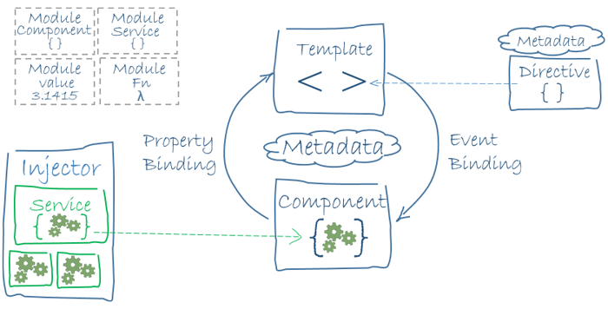
Angular App Architecture

Slide 24
Create Project - Angular CLI
Command line interface tool to initialize, develop, scaffold and maintain Angular applications
Generating and serving an Angular project
Insrall CLI: npm install -g @angular/cli@7
Check the installation: ng --version
Create App: ng new DemoApp
Routing? Y
Style? SCSS
Go to app root: cd DemoApp
Run the app: ng serve / npm run start
Navigate to http://localhost:4200/

Slide 25
Angular CLI
You can use the ng generate (or just ng g) command
Scaffold | Usage
Component | ng g component my-new-component
Directive | ng g directive my-new-directive
Pipe | ng g pipe my-new-pipe
Service | ng g service my-new-service
Class | ng g class my-new-class
Guard | ng g guard my-new-guard
Interface | ng g interface my-new-interface
Enum | ng g enum my-new-enum
Module | ng g module my-module

Slide 26
Bootstrapping
JIT compiler at browser: platform-browser-dynamic
platform-browser-dynamic
JIT compiler bootstraps module
platformBrowserDynamic().bootstrapModule(AppModule);
AppModule bootstraps AppComponent
@NgModule({
declarations: [AppComponent],
imports: [BrowserModule,AppRoutingModule],
bootstrap: [AppComponent]
})
export class AppModule { }
Module
Component
AppComponent and children tree
AppComponent’s view is loaded.
All the children components appearing in AppComponent’s view are also loaded.

Slide 27
Modules
Angular modules
Modules are used in Angular to put logical boundaries in your application.
It is a mechanism to group components, directives, pipes and services that are related
To define modules we have to use the decorator NgModule().
JavaScript also has its own module system for managing collections of JavaScript objects. It's completely different and unrelated to the NgModule system.

Slide 28
Module Loaders
Popular JS module loaders
CommonJS
AMD
ES2015
Pros Simple: a developer can grasp the concept without looking at the docs. Dependency management is integrated: modules require other modules and get loaded in the needed order. require can be called anywhere: modules can be loaded programmatically. Circular dependencies are supported. | Cons Synchronous API makes it not suitable for certain uses (client-side). One file per module. Browsers require a loader library or transpiling. No constructor function for modules (Node supports this though). Hard to analyze for static code analyzers.
Pros Asynchronous loading (better startup times). Circular dependencies are supported. Compatibility for require and exports. Dependency management fully integrated. Modules can be split in multiple files if necessary. | Constructor functions are supported. Plugin support (custom loading steps). Cons Slightly more complex syntactically. Loader libraries are required unless transpiled. Hard to analyze for static code analyzers.
Pros Synchronous and asynchronous loading supported. Syntactically simple. Support for static analysis tools. | Integrated in the language (eventually supported everywhere, no need for libraries). Circular dependencies supported. Cons Still not supported everywhere..
Read More - https://auth0.com/blog/javascript-module-systems-showdown/

Slide 29
Webpack
Loads the modules asynchronously as & when required
ES2015 introduced a new syntax for module loading
It allows for modules to be loaded selectively and asynchronously
TypeScript supports the ES2015 module loading syntax
Webpack allows to add module loading to applications that run ES5
TypeScript will transpile (compile) the application's components to ES5
Webpack will load them as ES5 modules
Each of TypeScript files will be compiled to a Webpack module
Webpack will then load all the related dependencies and when requested the module itself.
Not limited to Webpack module loader or pure TypeScript compiler
SystemJS (https://github.com/systemjs/systemjs)
Babel (https://babeljs.io/)

Slide 30
EXERCISE
Create new modules
Add couple of new modules to your application using @angular/cli
ng g module accounts
ng g module employees --routing
ng g module auth --routing
And explore the generated code.

Slide 31
Components
Building block of a web app
Component Pattern instead of MVC
A component controls a patch of screen called a view.
A class with template and decorator
Template
Class
Decorator

Slide 32
EXERCISE
Create new components
Add few components to auth module.
ng g component auth/login
ng g component auth/forgot-password
ng g component auth/sign-up
Add few components to employees module
ng g component employees/employee-list
ng g component employees/employee-details
And explore the generated code.

Slide 33
Templates
The view of component
Defines the user interface. Contains the HTML, directives and bindings.
You define a component's view with its companion template.
A template is a form of HTML that tells Angular how to render the component.
Inline template
template: `<h1>
Welcome to {{title}}!
</h1>`
templateUrl
templateUrl: 'app/app.component.html'

Slide 34
Style with SCSS (“Sassy CSS”)
A superset of CSS's syntax. A valid CSS stylesheet is valid SCSS as well.
_vars.scss
Add variables in _vars.scss in /src/ directory
$font-color: white;
$background-color: gray;
$blue-text: blue; $custom-text-color: orange;
$custom-font-size: 40px;
Global style
styles.scss
@import '_vars.scss';
body{
color: $font-color;
background-color: $background-color;
}
Component.scss
Scoped style for component
@import '../_vars.scss'; h2{
color: $blue-text;
}
.customClass{
color: $custom-text-color;
font-size: $custom-font-size;
}

Slide 35
Directives
There are three kinds of directives in Angular
Directives
Attribute
Structural
Components
change the appearance or behavior of an element, component, or another directive.
[ngClass]
[ngStyle]
change the DOM layout by adding and removing DOM elements.
*ngIf
*ngFor
*ngSwitch
directives with a template

Slide 36
EXERCISE
Create a custom directive
Create the directive
ng generate directive highlight
Add logic for the directive
import { Directive, ElementRef } from '@angular/core';
@Directive({
selector: '[appHighlight]'
})
export class HighlightDirective {
constructor(el: ElementRef) {
el.nativeElement.style.backgroundColor = 'red';
}
}
Apply the attribute directive
<p appHighlight>Highlight me!</p>

Slide 37
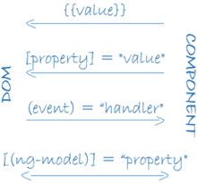
Bindings
Sync data between class and template of a component
There are four forms of data binding syntax
import { FormsModule } from "@angular/forms";

Slide 38
Bindings cont…
Different ways to bind
<h3>Property Binding</h3>
<h4>Message: {{message}}</h4>
<h4 innerHTML="{{message}}">Message: </h4>
<h4 bind-innerHTML=message>Message: </h4>
<h4 [innerHTML]=message>Message: </h4>
<h4>Message: <span [textContent]=message></span></h4>
<h3>Event Binding</h3>
<button on-click="change()">Click to Change</button>
<button (click)=change()>Click to Change</button>
<h3>Two Way Binding</h3>
<input type="text" [value]=message>
<input type="text" bindon-ngModel=message>
<input type="text" [(ngModel)]=message>
<input type="text" [(ngModel)]=name>
<h3>Hello, {{name}}</h3>

Slide 39

EXERCISE
Complete and explore all the forms of bindings
Create a counter as shown below.
On click of Increase button Current Count should increase by Count By value.
On click of Decrease button Current Count should decrease by Count By value.

Slide 40
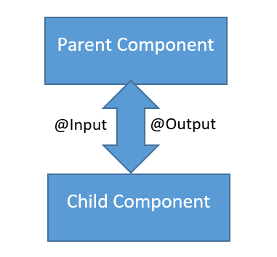
Data flow – Component interaction
Passing data between components
Pass data from parent to child with input binding
import {Input, Output, EventEmitter } from "@angular/core";
Parent listens for child event: EventEmitter property
Parent interacts with child via local variable or @ViewChild()
Parent and children communicate via a service

Slide 41
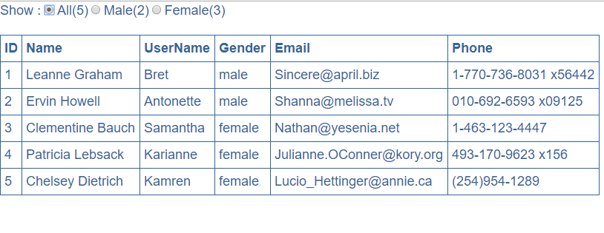
Data flow – Component interaction Cont…
Component Tree:
AppComponent => UserListComponent => UserCountComponent

Slide 42
Pipes
Transform data before display
Built in pipes include lowercase, uppercase, decimal, date, percent, currency etc
Usage
<td>{{today | date:'fullDate' |uppercase }}</td>
More details on built in pipes -
https://angular.io/api?type=pipe
Create custom Pipes - capitalize, filter
ng g pipe my-pipe

Slide 43
Pipes - Custom Pipe
A pipe is a class decorated with pipe metadata
Step 1
Import
import { Pipe, PipeTransform } from '@angular/core';
Add filter class decorated with Pipe()
@Pipe({
name: "filter"
})
export class FilterPipe implements PipeTransform {
transform(value: any[], args = ""): any {
return value.filter(item => item.name.indexOf(args) !== -1);
}
Step 2
Step 3
Use the pipe
<ng-container *ngFor="let user of users | filter:filterBy">

Slide 44
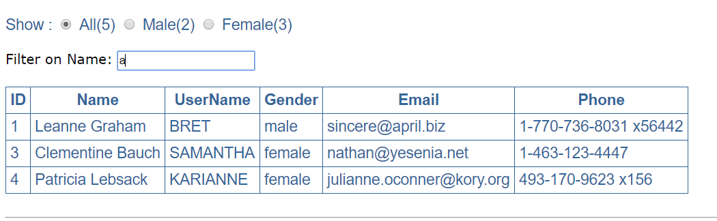
Pipes - Custom Pipe
Create custom Pipes using command
ng g pipe pipes/capitalize
ng g pipe pipes/filter

Slide 45
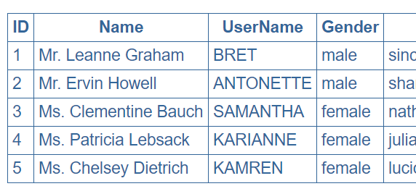
EXERCISE
Create a custom Pipe
Create a custom Pipe - AppendSalutation.
This pipe should take Name and Gender as input and returns Name with Salutation (Mr. / Ms.) appended to it.
As seen below:

Slide 46
Forms
Templates with specific input fields
You can build almost any form with an Angular template—login forms, contact forms, and pretty much any business form.
Declare a template variable for the form
Template driven Forms
<form class="form-horizontal" #form1="ngForm" (submit)="logForm(form1.value)">
<input type="text" class="form-control" name="firstname" ngModel>
Model driven Forms
<form class="form-horizontal" (submit)="logForm()">
<input type="text" class="form-control" name="firstname" [(ngModel)]="person.firstname">
You add the same validation attributes as you would with native HTML form validation. Angular uses directives to match these attributes with validator functions in the framework.

Slide 47
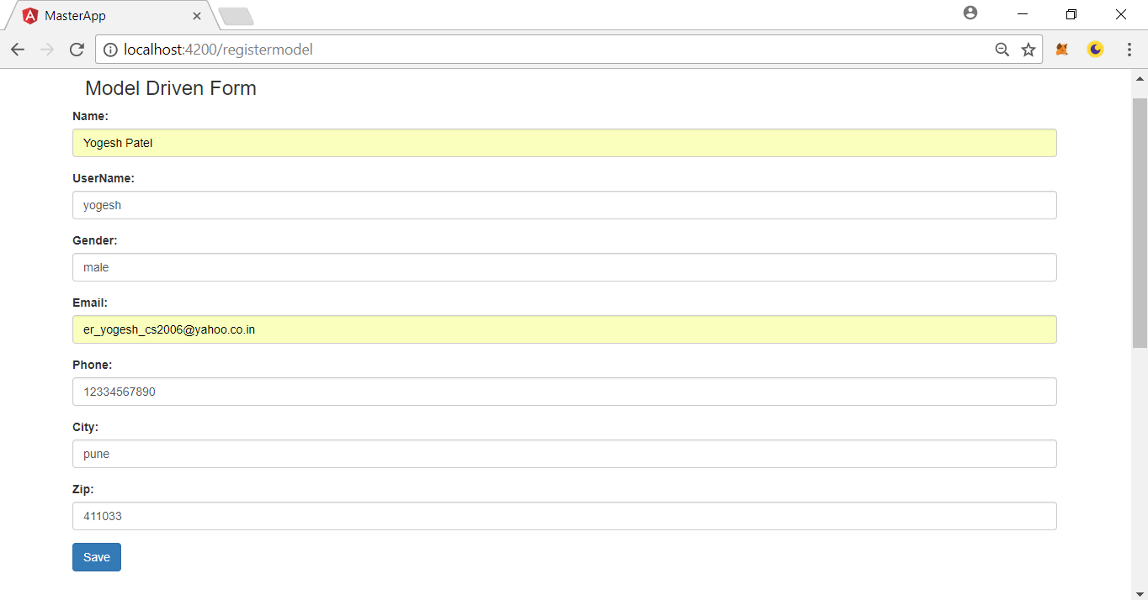
Forms

Slide 48
Reactive Forms
Reactivity feature of Angular
Reactive forms is an Angular technique for creating forms in a reactive style
import { FormsModule, ReactiveFormsModule, FormBuilder, Validators } from "@angular/forms";
You create and manipulate form control objects directly in the component class.
<form class="form-horizontal" [formGroup]="registerForm" (submit)="logForm(registerForm.value)">
<input type="text" class="form-control" formControlName="firstname">
Reactive forms are synchronous. Template-driven forms are asynchronous. It's the difference that matters.
Instead of adding validators through attributes in the template, you add validator functions directly to the form control model in the component class.
ngOnInit() {
this.registerForm = this.fb.group({
firstname: [null, Validators.required],
lastname: [null, Validators.compose([Validators.required,
Validators.minLength(2), Validators.maxLength(20)])],
address: this.fb.group({
city: [null, Validators.required],
zip: 0 }) });

Slide 49
Validations
Multiple ways are supported for validating user inputs
HTML validation attributes
Forms Validators https://angular.io/api/forms/Validators
Every time the value of a form control changes, Angular runs validation and generates either a list of validation errors, which results in an INVALID status, or null, which results in a VALID status.
<div class="text-danger" *ngIf="registerForm.get('firstname').hasError('required') && registerForm.get('firstname').touched">
FirstName is required.....
</div>
<div class="text-danger" *ngIf="registerForm.get('lastname').touched">
<p *ngIf="registerForm.get('lastname').hasError('required') ">LastName is required.....</p>
<p *ngIf="registerForm.get('lastname').hasError('minlength') ">Min Length.....</p>
<p *ngIf="registerForm.get('lastname').hasError('maxlength') ">Max Length.....</p>
</div>

Slide 50
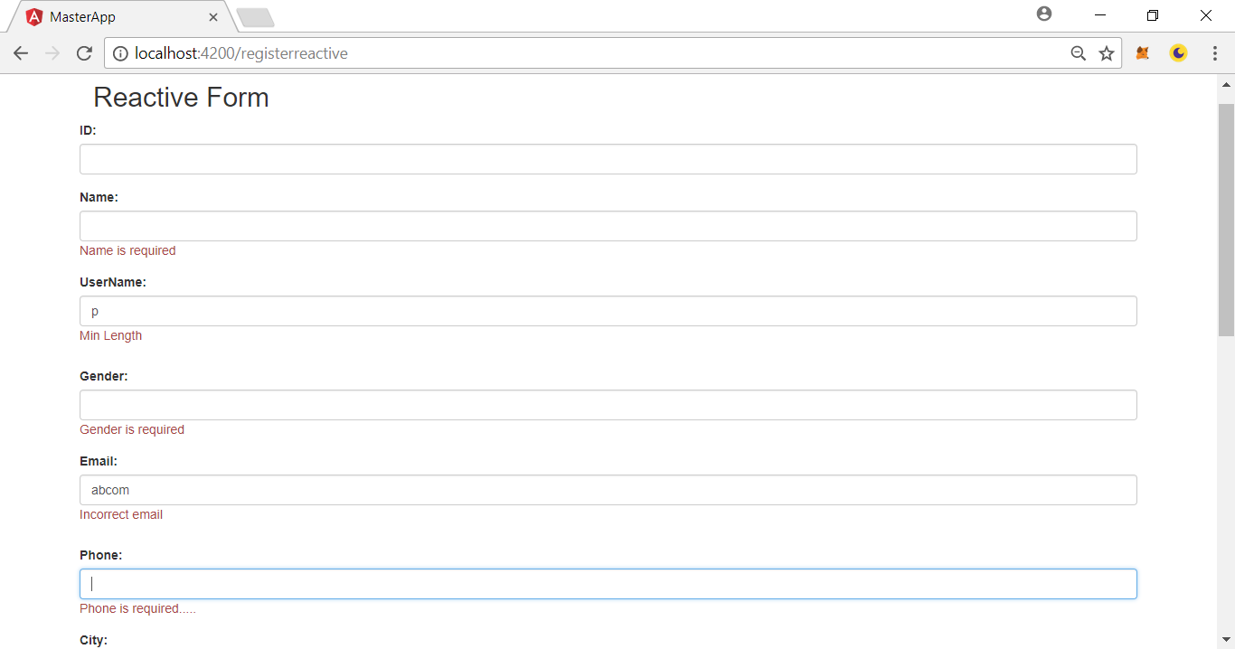
Validations

Slide 51
Template driven Vs Reactive forms
Template Driven Forms Features
Easy to use
Suitable for simple scenarios and fails for complex scenarios
Similar to AngularJS
Two way data binding(using [(NgModel)] syntax)
Minimal component code
Automatic track of the form and its data(handled by Angular)
Unit testing is another challenge
Reactive Forms Features
More flexible, but needs a lot of practice
Handles any complex scenarios
No data binding is done (immutable data model preferred by most developers)
More component code and less HTML markup
Reactive transformations can be made possible such as
Handling a event based on a debounce time
Handling events when the components are distinct until changed
Adding elements dynamically
Easier unit testing

Slide 52
Exercise
Create AuthModule forms
Create Login form using - template driven form
Create SignUp form using - reactive form
Create ForgotPassword form using model driven form
Add proper validations in all the three forms

Slide 53
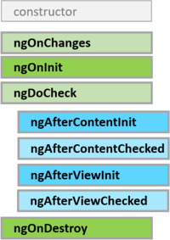
Lifecycle hooks
A component has a lifecycle managed by Angular
export class SimpleComponent implements OnInit { }

Slide 54
Exercise
Implement life cycle hooks
Import and implement all the life cycle hooks in app.component.ts
Use console.log(‘hook name’) in each method.
Run the app and see the sequence of execution in browser console.

Slide 55
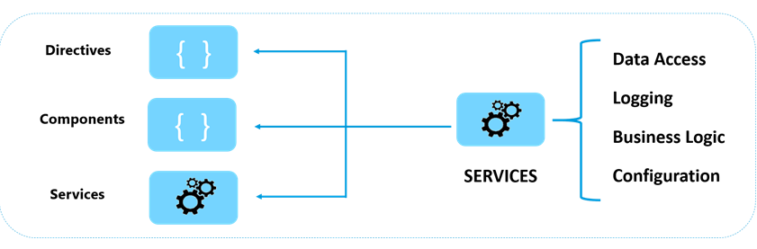
Services

Slide 56
Services
Service in Angular is just a class
Why we need a service in Angular
Best practise is to always use @Injectable() decorator
@Injectable()
export class EmployeeService {}
Injecting and using the service
constructor(private _employeeService: EmployeeService) { }
ngOnInit() {
this.employees = this._employeeService.getEmployees();
}
Difference between constructor and ngOnInit
A class constructor is automatically called when an instance of the class is created. It is generally used to initialise the fields of the class and it's sub classes.
ngOnInit is called after the constructor and is generally used to perform tasks related to Angular bindings.
Tasks that are time consuming should use ngOnInit instead of the constructor.
We register a service with the angular injector by using the
providers: [EmployeeService] // declaring it in the providers array

Slide 57
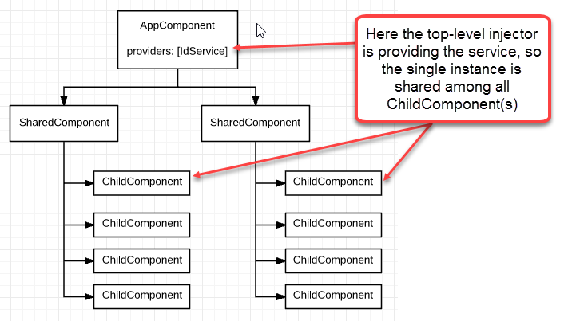
Dependency Injection

Slide 58
Dependency Injection
One of thr most powerful feature of Angular
When an instance of the component is created, the angular injector creates an instance of the service class and provides it to component constructor.
constructor(private _employeeService: EmployeeService) { }
Component which is dependent on a service instance, receives the instance from an external source rather than creating it itself. This is called Dependency Injection.
Allows components and other building blocks
To receive services by declaring dependencies on them using constructor parameters
To share objects throughout an application
To avoid the need to distribute shared objects manually

Slide 59
Exercise
Create AuthService
Create a new service “AuthService” using cli command
ng g service services/auth
Add a method “login(username, password)” that receives two parameters and returns “true” for successful login, “false” otherwise.
Register this service with Auth module.
Inject this service in Login component and use the login() method to authenticate users.
Follow similar steps for register() method and forgotPassword() method of SignUpComponent and ForgotPasswordComponent respectively.

Slide 60
Http
Making server calls in easy and clean way
HTTP requests are sent by the browser on behalf of the application
asynchronous - the application continues to operate while the browser is waiting for the server to respond
allows Angular to interact with web services/APIs
persistent data can be loaded into the application and changes can be sent to the server and saved
Requests are made using the Http class, delivered as a service through dependency injection
This class provides an Angular-friendly wrapper around the browser’s XMLHttpRequest feature

Slide 61
Http cont..
Steps to make a server call using http service
Step 1
It’s a separate module, import it.
import {HttpClientModule} from "@angular/common/http";
import {HttpClient, HttpHeaders } from "@angular/common/http";
Step 2
Inject the service and assign it to a local object
constructor(private http: HttpClient) { }
Make http call
Step 3
getUsers() {
const headers = new HttpHeaders();
headers.append("Authorization", "Check");
return this.http.get<IUserShort[]>(this.url, {
headers: headers
});
}
Step 4
Subscribe and extract data from response
this.userService.getUsers().subscribe(users => {
this.users = users;
});

Slide 62

RxJS
The Reactive Extensions for JavaScript
RxJS is a library for reactive programming using Observables, to make it easier to compose asynchronous or callback-based code.
The essential concepts in RxJS which solve async event management are:
Observable: represents the idea of an invokable collection of future values or events.
Observer: is a collection of callbacks that knows how to listen to values delivered by the Observable.
Subscription: represents the execution of an Observable, is primarily useful for cancelling the execution.
Operators: are pure functions that enable a functional programming style of dealing with collections with operations like map, filter, concat, flatMap, etc.
Subject: is the equivalent to an EventEmitter, and the only way of multicasting a value or event to multiple Observers.
Schedulers: are centralized dispatchers to control concurrency, allowing us to coordinate when computation happens on e.g. setTimeout or requestAnimationFrame or others.
Normally you register event listeners.
var button = document.querySelector('button');
button.addEventListener('click', () => console.log('Clicked!'));
Using RxJS you create an observable instead.
var button = document.querySelector('button');
Rx.Observable.fromEvent(button, 'click').subscribe(() => console.log('Clicked!'));

Slide 63
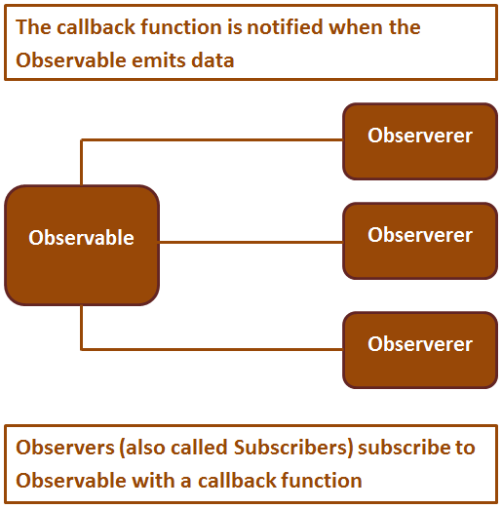
Observable

Slide 64
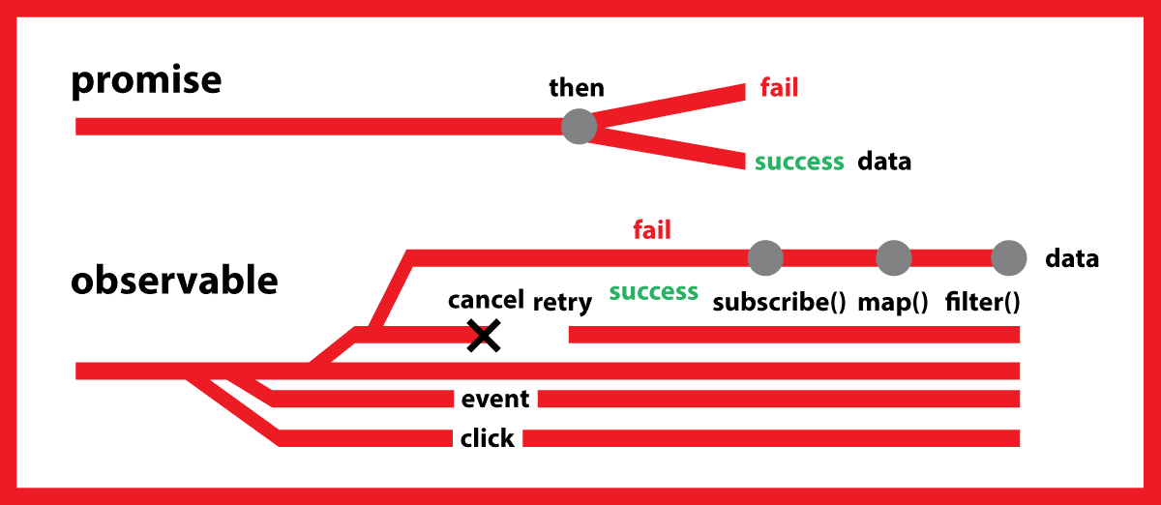
Observable Vs Promise

Slide 65
Exercise
Use Http post() method
Create a new register() method in AuthService
Use http.post() method to post user details to - 'https://jsonplaceholder.typicode.com/users‘ url
Update SignUp component to post user data to register() method of AuthService and display log the message on successful post.
this.http.post(this.url, user, { headers: headers }).subscribe(res => { console.log(res); });
Check the functionality of Observable<> and subscribe() method.

Slide 66
State Management
UI state management with Redux
Applications use state stores to hold state. These are called different things in different frameworks, like store, reducer and model, but at the core they are all just a plain object.
State is a single immutable data structure
Actions describe state changes
Pure functions called reducers take the previous state and the next action to compute the new state
State accessed with the Store, an observable of state and an observer of actions
In Angular, there are 3 ways to manage state
Redux using @ngrx;
Redux using ng2-redux; and
Angular Services and RxJS
@ngrx/store is a controlled state container

Slide 67
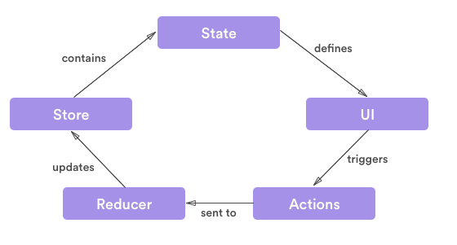
State management with @ngrx/store

Slide 68
State management with @ngrx/store
RxJS powered state management for Angular applications, inspired by Redux
Store - single source of truth
Reducer - knows what to do with a given action and the previous state
Actions - type & payload that contains needed information to alter your store
Dispatcher - entry point for you to dispatch your action
Middleware - functions that will intercept each action that is being dispatched in order to create side effects
Step 1: npm install @ngrx/store@5 --save
Step 2: Create reducer user.reducer.ts that defines AppState, ACTIONS, usersReducer()
Step 3: In component, select data from Store<AppState>
Step 4: Update service to add loadUsers() method and use Store<AppState>
Step 5: Import into AppModule - StoreModule. forRoot({ users: usersReducer })
Step 6: Update html to use async pipe for users collection

Slide 69
Exercise
Handle user login with ngrx state management
Create auth.reducer.ts and define AuthState, ACTIONS, authReducer()
Add reducer to app.module
Update auth.service to dispatch DoLoginAction on successful login.
In app.component read current state value from isLoggedIn state.
Display “Login” menu only if isLoggedIn is false

Slide 70
Routing
Changing urls and views at browser
Steps to implement routing
Set <base href="/"> in the application host page which is index.html
Define routes in app.routes.ts
Import RouterModule and add Routes array to app.module.ts
Associate routes with application navigation menu
Add <router-outlet></router-outlet>
Route Params
Create a route with parameters
{ path: 'users/:username', component: UserDetailsComponent }
Bind to the route using the [routerLink] directive with link parameters array
The first element in the array is the path of the route to the destination component
The second element in the array is the route parameter value
<a [routerLink]="['/users',userName]">
{{userName | uppercase}} </a>
To retrieve the parameter from the URL use ActivatedRoute service
ngOnInit() {
const userName: string = this.activatedRoute.snapshot.params[‘username'];
}

Slide 71
Exercise
Implement Routing
Implement routing for Employees module.
Create new feature module - orders with routing
ng g module orders --routing
Add new component to it - “order-list”
ng g component orders/order-list
Add new component - “order-details”
ng g component orders/order-details
Implement routing for Orders module.

Slide 72
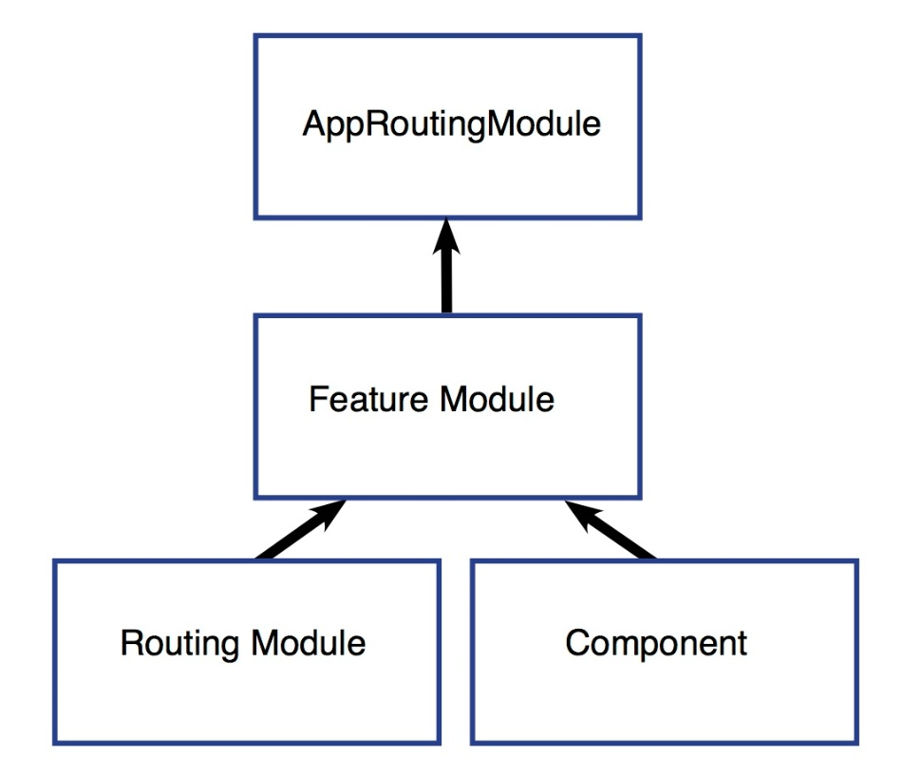
Lazy Loading
Load modules on demand - improve performance
There are three main steps to setting up a lazy loaded feature module:
Create the feature module.
Create the feature module’s routing module.
Configure the routes.
Route at the parent level
{ path: 'auth', loadChildren: './auth/auth.module#AuthModule' }
Feature module’s routes
RouterModule.forChild(routes)

Slide 73
Exercise
Implement lazy loading
Implement lazy loading for Employees module.
Implement lazy loading for Orders module.

Slide 74

Code Quality
Ensuring code quality of Angular project
TSLint
TSLint is an extensible static analysis tool that checks TypeScript code for readability, maintainability, and functionality errors.
Codelyzer
A set of tslint rules for static code analysis of Angular TypeScript projects.
Angular CLI has support for codelyzer
Validate your code with CLI and the custom Angular specific rules
ng new codelyzer
ng lint

Slide 75
Exercise
Improve code quality of code
Execute following command
ng lint
Resolve the issues reported by lint.

Slide 76
Unit Testing
Ensuring quality of the code
Karma – test runner / Jasmine – unit test framework
Step1: Import from @angular/core/testing
import { TestBed, async } from '@angular/core/testing';
Step2: Add describe('AppComponent', () => {});
Step3: Inject dependencies
beforeEach(async(() => {}));
Step4: Unit test
it('should create the app', async(() => {
const fixture = TestBed.createComponent(AppComponent);
const app = fixture.debugElement.componentInstance;
expect(app).toBeTruthy();
}));
Run unit test: ng test

Slide 77
Jasmine testing framework
Default set of matchers
expect(instance).toBe(instance);
expect(number).toBeCloseTo(number, decimalPlaces);
expect(mixed).toBeDefined();
expect(mixed).toBeFalsy();
expect(number).toBeGreaterThan(number);
expect(number).toBeLessThan(number);
expect(number).toBeNaN();
expect(mixed).toBeNull();
expect(mixed).toBeTruthy();
expect(mixed).toBeUndefined();
expect(array).toContain(member);
expect(mixed).toEqual(mixed);
expect(spy).toHaveBeenCalled();
expect(spy).toHaveBeenCalledTimes(number);
expect(spy).toHaveBeenCalledWith(...arguments);
expect(mixed).toMatch(pattern);
expect(fn).toThrow(string);
expect(fn).toThrowError(string);

Slide 78
EXERCISE
Writing unit tests
Write unit tests for auth.service.spec.ts
Add unit test in login.component.spec.ts to test login() method.
Add unit test in sign-up.component.spec.ts to test signUp() method.
Add unit test in forgot-password.component.spec.ts to test forgotPassword() method.

Slide 79
Code Coverage
Code coverage reports allows to see parts of code base that may not be properly tested by unit tests.
Generate Code Coverage report: ng test --watch=false --code-coverage
See Code Coverage report
Using http-server -
Install server to see report: npm install -g http-server
See Code Coverage report: http-server -c-1 -o -p 9875 ./coverage
Open the coverage folder and run index.html in a browser.
Code Coverage Enforcement - open the karma.conf.js and add the following in the coverageIstanbulReporter: key
coverageIstanbulReporter: {
reports: [ 'html', 'lcovonly' ],
fixWebpackSourcePaths: true,
thresholds: {
statements: 80,
lines: 80,
branches: 80,
functions: 80
}
}

Slide 80
Debugging Angular App
Some helpful tools for development and debugging
Browser's developer console - a lot of errors with code can be detected just by looking at it
put in breakpoints, add a watch, etc
Augury (https://augury.angular.io/)
Helps visualise the application through component trees, and visual debugging tools
Gives insight into application structure, change detection and performance characteristics
IDE: Visual Studio Code, JetBrains WebStorm, Sublime Text, Atom, etc
JSFiddle and Plunker
playgrounds for trying out HTML, CSS, and JavaScript code
with versioning and sharing capabilities (http://jsfiddle.net/, http://plnkr.co/)

Slide 81
The Ahead-of-Time (AOT) Compiler
Converts your Angular HTML and TypeScript code into efficient JavaScript code during the build phase before the browser downloads and runs that code.
Angular offers two ways to compile your application
Just-in-Time (JIT), which compiles your app in the browser at runtime
ng build
ng serve
Ahead-of-Time (AOT), which compiles your app at build time.
ng build --aot / ng build --prod
ng serve --prod
Further reduce bundle sizes by adding the build-optimizer flag.
ng build --prod --build-optimizer
Why compile with AOT?
Faster rendering
Fewer asynchronous requests
Smaller Angular framework download size
Detect template errors earlier
Better security

Slide 82
Deployment
Deploy built code to web server (IIS)
Copy the generated ‘dist’ folder code to deployment folder.
Create a new website in IIS.
Point to the deployment folder.
Browse the app.

Slide 83
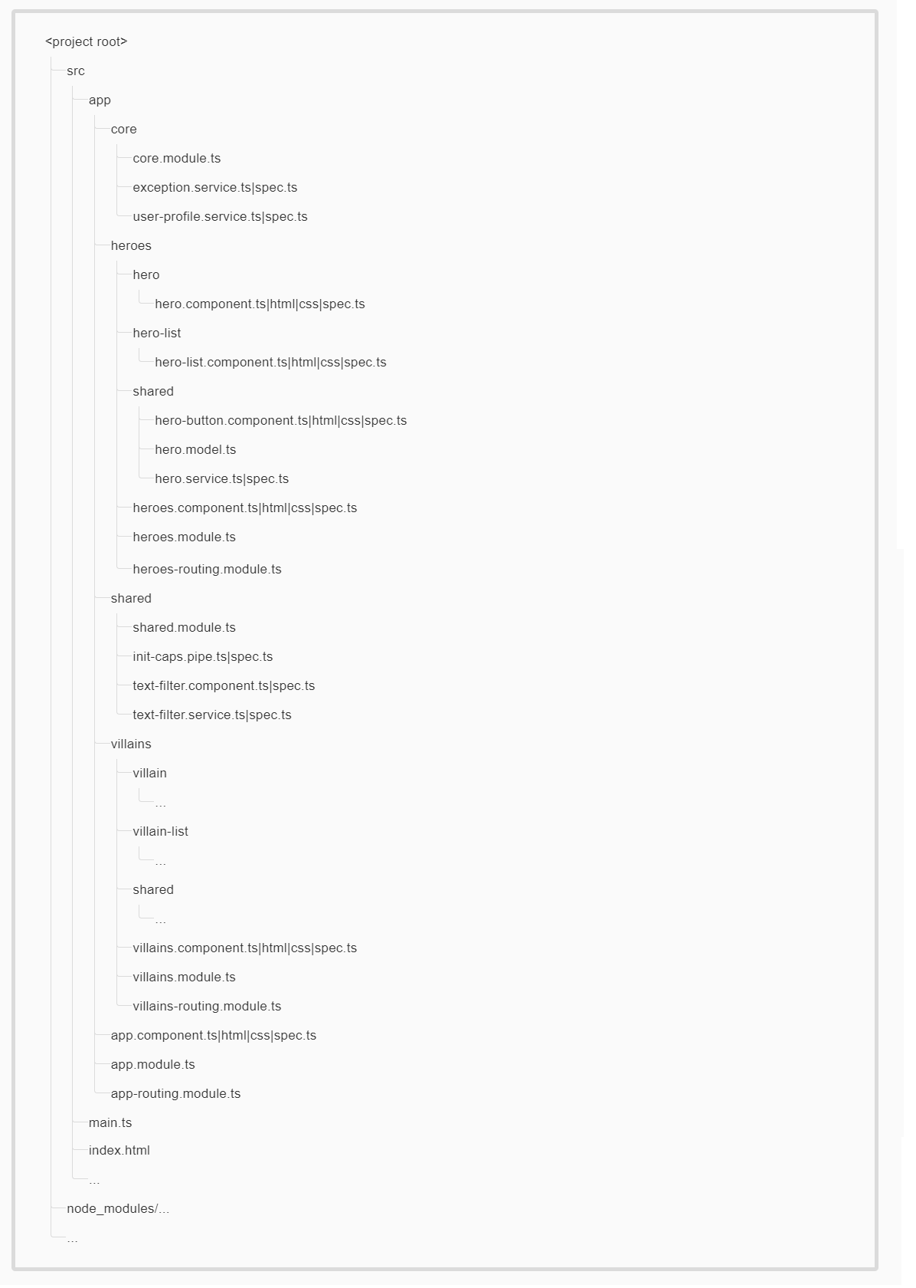
App Structure

Slide 84
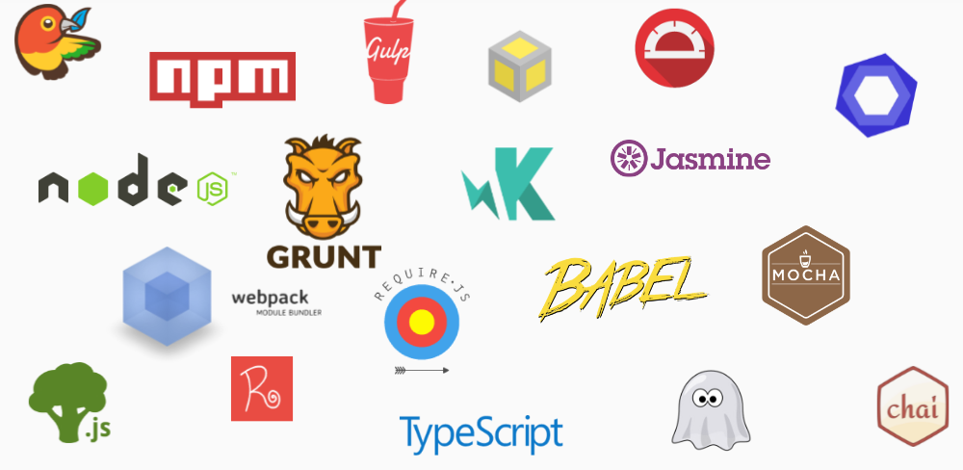
Tooling
You need some transpiler and a build tool that transpiles the code and serves it up, not to mention then optimizations like minification, inclusion of HTML templates, CSS compilation etc.

Slide 85
Resources
Resources for reference and further exploration
Angular source code, documentation and blog
https://angular.io/docs
Awesome Angular https://github.com/AngularClass/awesome-angular
Communities
https://gitter.im/angular/angular
https://groups.google.com/forum/#!forum/angular
UI library - https://www.primefaces.org/primeng/
AngularJS - Angular mapping
https://angular.io/guide/ajs-quick-reference

Slide 86
Create Project - without Angular CLI
Angular 7 + Webpack 4 project
Step by step process
GoTo Article
Source
Source on github.com

Slide 87

Any questions?
Questions & Answers

Slide 88
Thank you!

